Slide 1
AnDLA MXSim Env
Introduction
2023/4/28

Slide 2
Introduction
Verification Language Community
Digital Model Behavior
Pyton
C++/SC
SC_AMS
PLI/DPI
PLI/DPI
Analog Model Behavior
Verilog/SV/SVA
UVM_SC/UVMC
VAMS
IF/XMR/
Config_db
UVM_AMS
Design Under Test
UVM
Test Bench

Slide 3
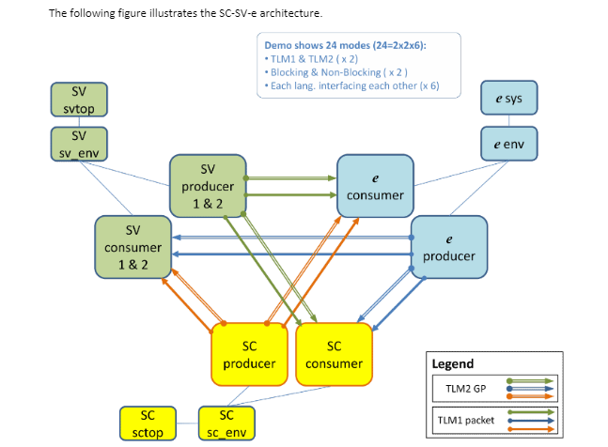
UVM-ML
Universal Verification Methodology Multi-Language (UVM-ML) provides a modular solution for integrating verification components written in different languages into a unified and coordinated verification environment.
SC
UVM
UVM-ML
e
SV

Slide 4
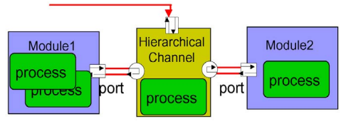
TLM with SystemC
Modules and Processes
System components are modeled as modules with a set of concurrent processes that represent the behavior
Interfaces
Modules exchange communication in the form of transactions by accessing the interfaces through the module port
Channels
TLM interfaces are implemented within channels to encapsulate communication protocol

Slide 5
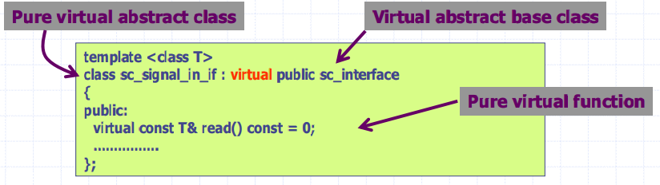
Interfaces
An interface defines a set of functions
Specify only the signature of each function
All interfaces must be derived from sc_interface
One can easily plug in different channel implementations with the same interfaces for channel refinemen

Slide 6
Ports (1/2)
Ports correspond to interfaces
Each kind of port must specify the interface to which it corresponds
Example: sc_port<sc_signal_in_if > portA;
Interface method calls
Example: portA->read()
read() is the interface function defined in sc_signal_in_if
All ports must be derived from sc_port_base

Slide 7
Ports (2/2)
sc_in
sc_inout (sc_out)
sc_fifo_in
Sc_fifo_out

Slide 8
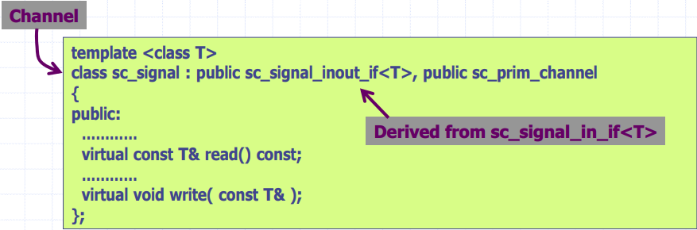
Channels (1/2)
Channels define how interface functions are performed
A channel may implement more than one interface

Slide 9
Channels (2/2)
Primitive Channels
hardware signals : sc_signal
FIFO channel : sc_fifo
mutual-exclusion lock : sc_mutex

Slide 10
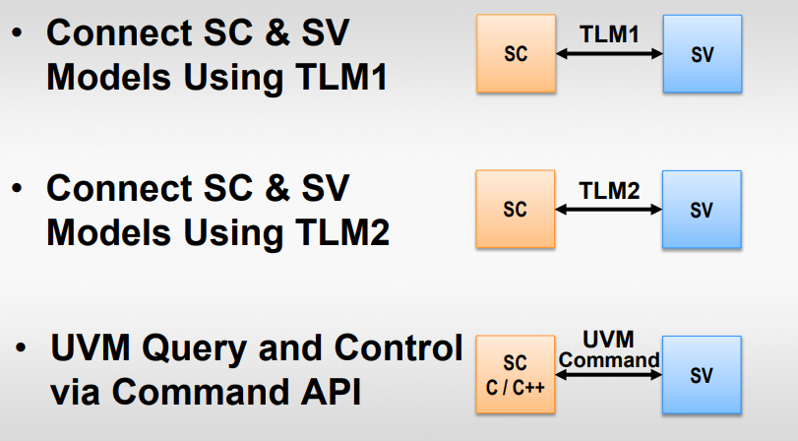
UVMC Concept

Slide 11
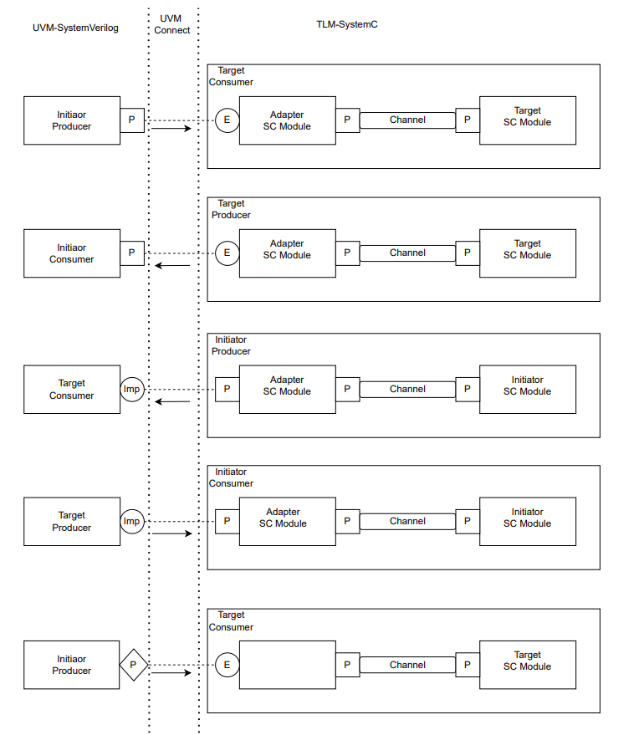
UVMC Paradigms

Slide 12
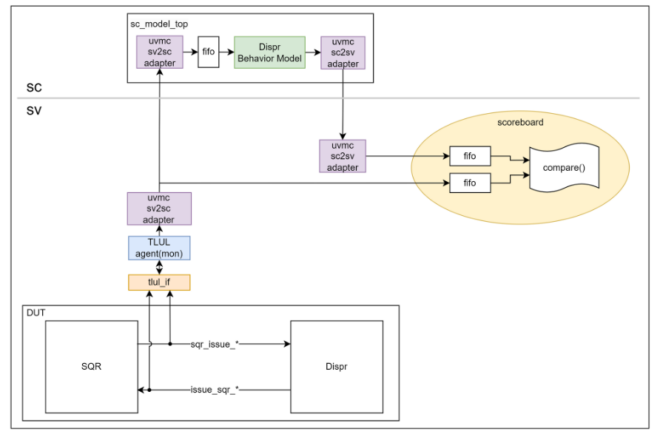
SV_SC Adapter

Slide 13
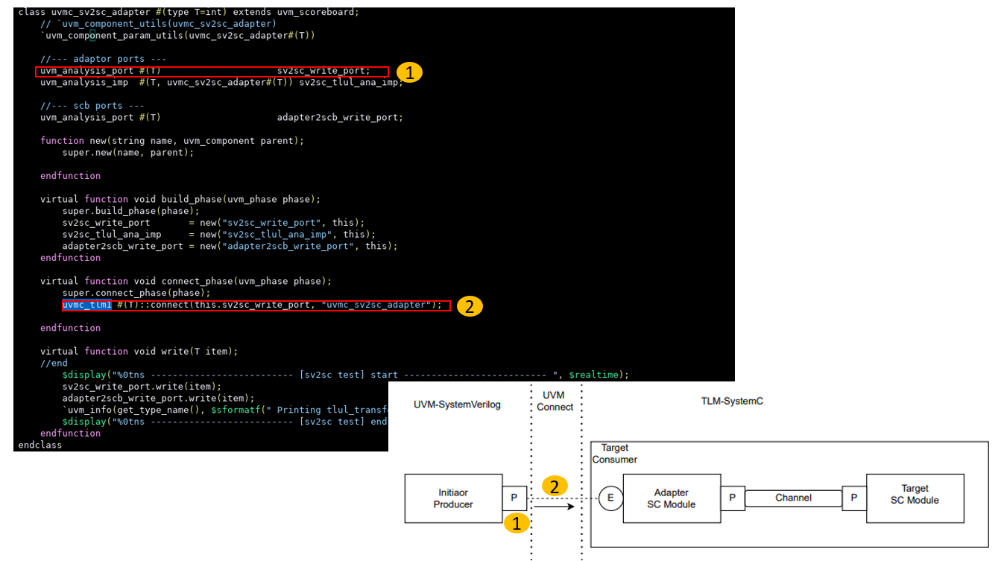
SV2SC Adapter (1/2)
UVM Side: uvmc_sv2sc_adapter

Slide 14
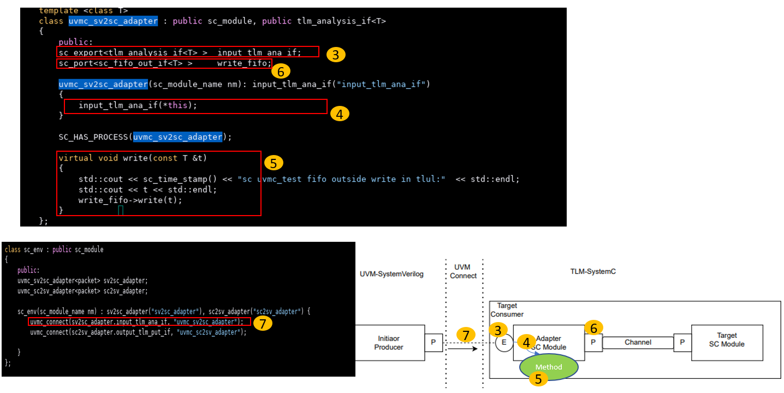
SV2SC Adapter (2/2)
SC Side: uvmc_sv2sc_adapter

Slide 15
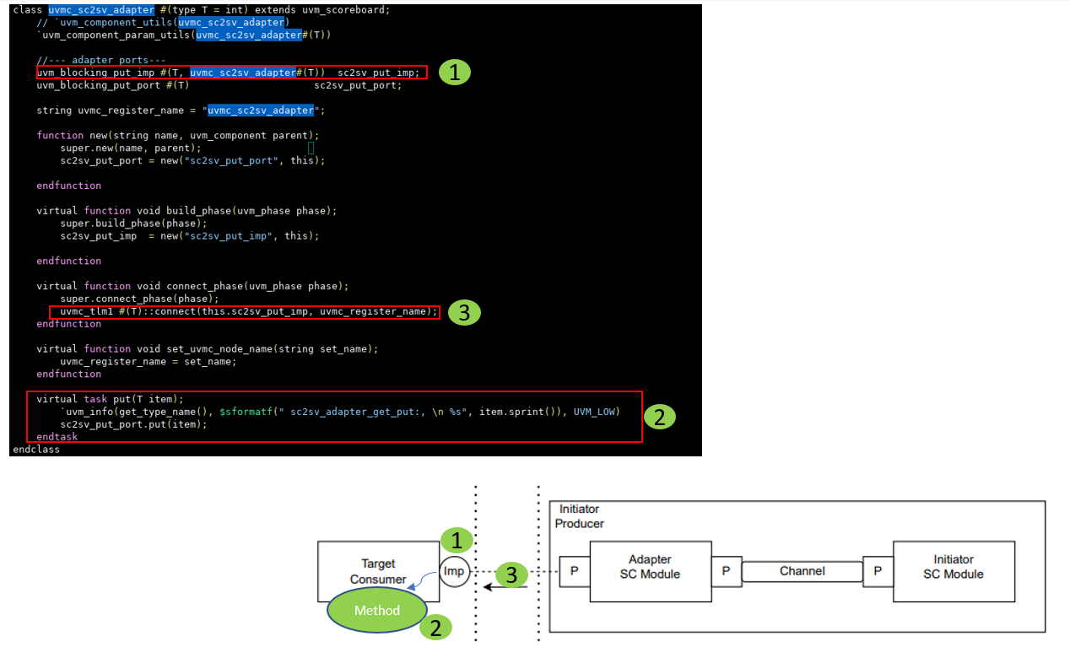
SC2SV Adapter (1/2)
UVM Side: uvmc_sv2sc_adapter

Slide 16
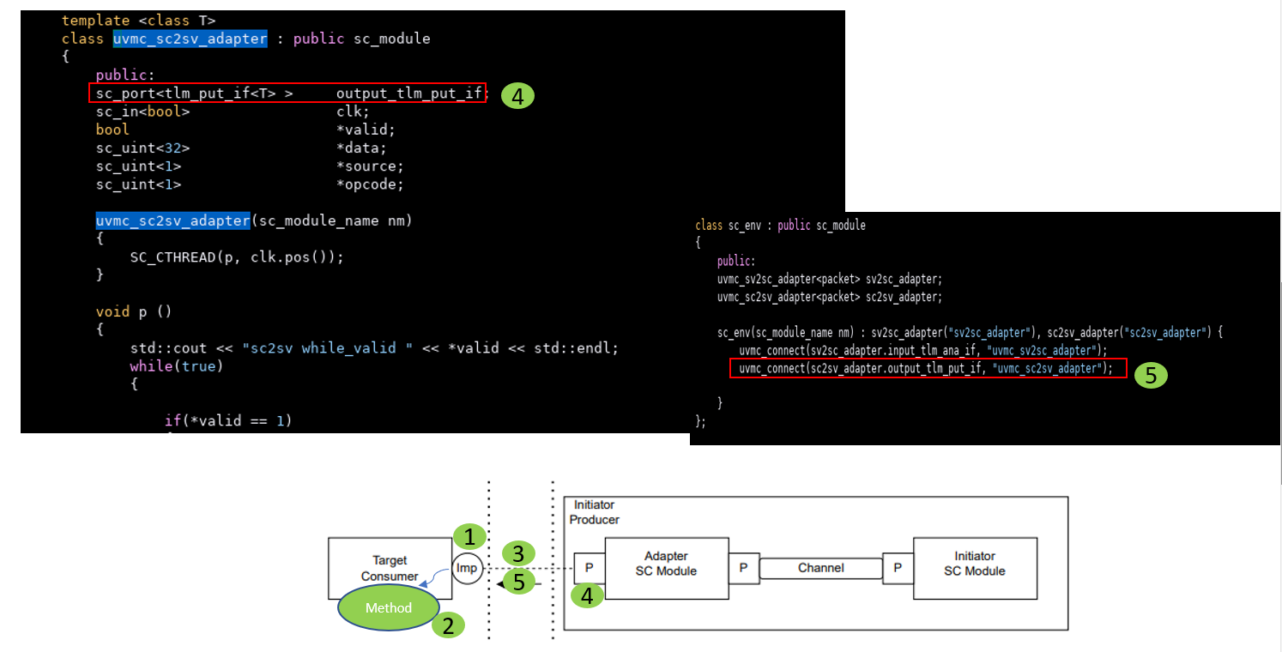
SC2SV Adapter (2/2)
SC Side: uvmc_sv2sc_adapter

Slide 17



Test Driver
Purpose: Any legacy C/C++ tests can be reused in a UVM based environment where the user does not have to recode the C/C++ routines.
Solutions
Using proprietary methods
Most major simulator vendors provide a built-in mechanism to integrate SystemC models with their simulator
Advantage: Simple to use (more details later)
Disadvantage: Not portable to other simulators
Using the Verilog Programming Language Interface (PLI)
Advantage: A standard that is portable to all simulators
Disadvantage: Difficult to do
Using the SystemVerilog Direct Programming Interface (DPI)
Advantages: Simple to use and portable
Disadvantage: Restrictions on data types

Slide 18
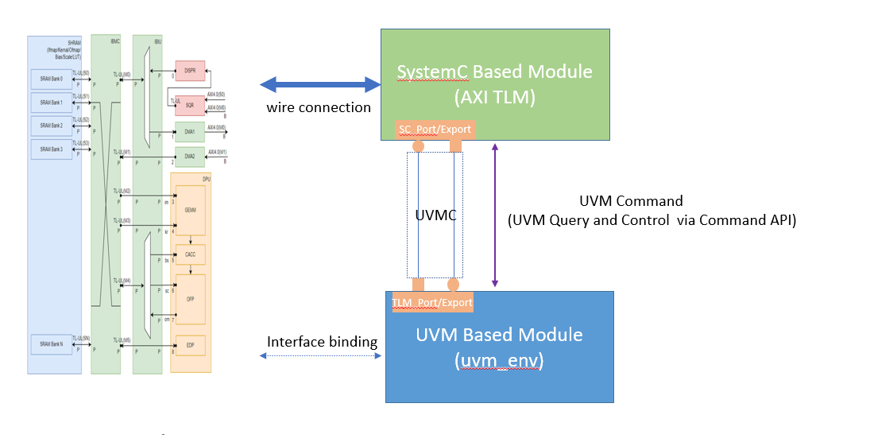
AnDLA MXSim Env
TileLink
SVA
C++
Program
Driver
Coverage
Channel
DUT
Collector/Checker

Slide 19
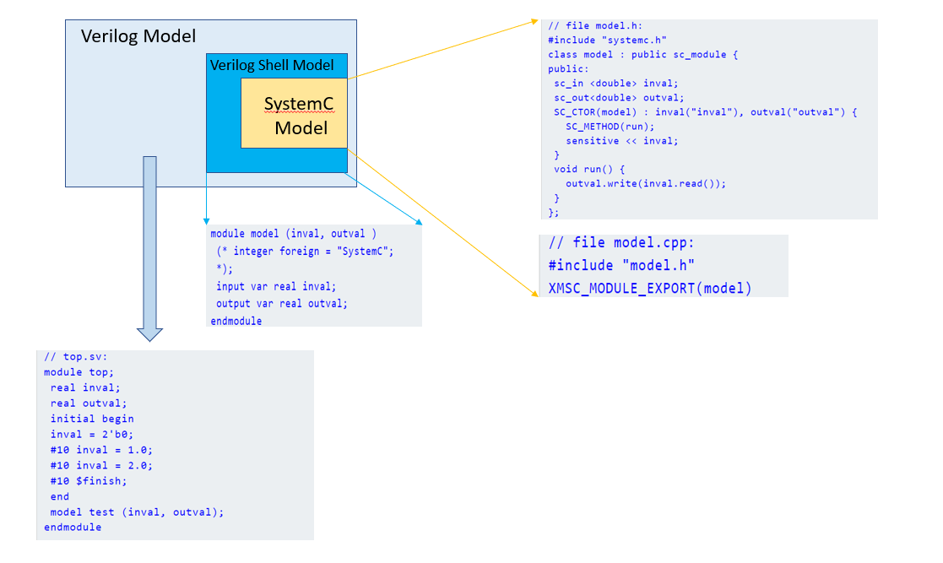
CDNS: NCSC_MODULE_EXPORT

Slide 20
AMBA SystemC Module
Arm AMBA Transaction-Level Modeling (TLM) library
simulate approximately-timed (AT) and cycle-accurate (CA) AXI4 and ACE ports. https://developer.arm.com/downloads/-/amba-tlm

